Slide 1
Git, GitHub 101

Slide 2
50K feet view
Git is a version control system that allows developers to track changes in their code.
GitHub is a web-based hosting service for git repositories.
In simple terms,
you can use Git without GitHub, but you cannot use GitHub without Git
Git is on your machine, GitHub is hosted on cloud

Slide 3
Git
Git is locally installed, typically projects specific, does not require internet to access
During the course of your project, each time you ‘commit’ the codebase a snapshot is added to Git repo.
This way Git helps you keep track of changes in your code. So, you can go back to any specific version you want.
Each such version is a snapshot created by a commit command.
When creating PPT deliverables we often resort to Save As to achieve this.

Slide 4
GitHub
GitHub is a web-based platform that hosts Git repositories. It provides a place for developers to store their code and collaborate with others. With GitHub, you can create repositories to store your projects and share them with the world.
GitHub offers additional features that make it easier for people to work together on projects. For example, you can create branches, which are copies of your code that you can experiment with without affecting the main version. This allows multiple people to work on different features of a project simultaneously. Once the changes are tested and ready, they can be merged back into the main codebase.
GitHub also includes a feature called "pull requests," which allows developers to propose changes to a project. It's like raising your hand and saying, "Hey, I made some improvements to the project. Can you take a look?" Other people can review the changes, provide feedback, and decide whether to merge them into the main codebase.

Slide 5
Popular Git and GitHub Softwares
Git
GitKraken, SourceTree, Bitbucket, GitLab, Apache Subversion (SVN), Git for Windows
GitHub
GitLab, Bitbucket, Azure DevOps (ex VSTS), AWS CodeCommit, Gitea

Slide 6
Set up
Create a GitHub Account:
Go to github.com and sign up for a new GitHub account if you don't have one.
Install GitHub Desktop:
Download and install GitHub Desktop from desktop.github.com.

Slide 7
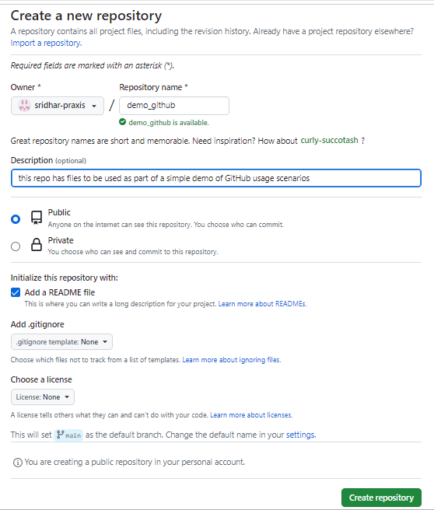
Step 1: Create a Repo
Create a New Repository on GitHub:
Click on the "+" sign at the top right corner and select "New repository."
Give your repository a name, e.g., "My-Project," add a description, and choose public visibility, add a readme & fill in a line about this repo in readme
Click "Create repository."

Slide 8
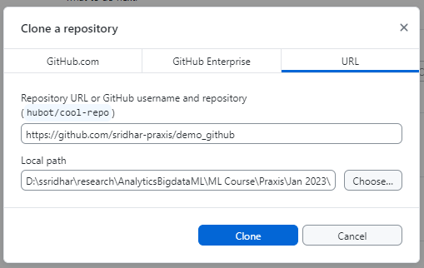
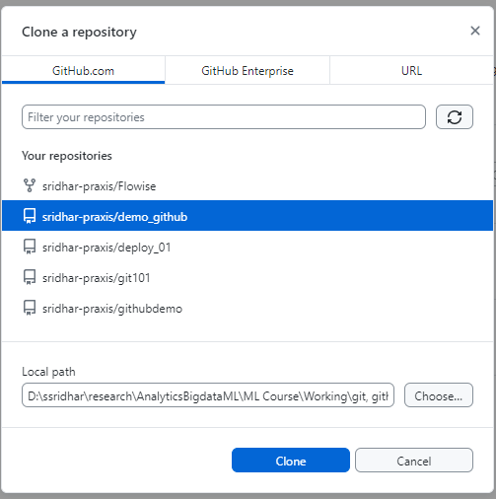
Step 2: Clone a Repo to your machine
Open GitHub Desktop and sign in with your GitHub account.
Click "Clone a repository" from the File menu.
Select from “Your repository” list OR Select URL and enter the repo URL
Include a local folder as destination, then Clone

Slide 9
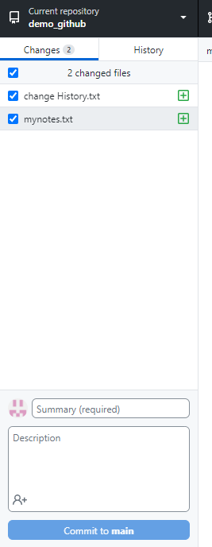
Step 3: Modify cloned repo
In your machine, navigate to this cloned repo using Explorer and add a file
For this demo it can even be empty or a copy / paste of an existing file.
I created two files in this repo – one is a blank Notepad file, second is paste of an existing file
Open GitHub Desktop and observe the changes reflect
Note how it is expecting commit to follow
Also, observe ‘to main’

Slide 10
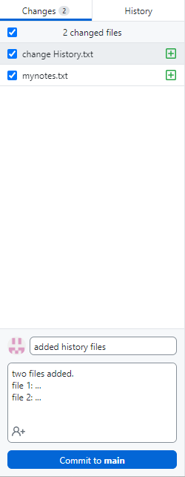
Step 4: Commit
Enter details in the textbox below
Commit
It is possible to Undo.
Try that too. Life saver.

Slide 11
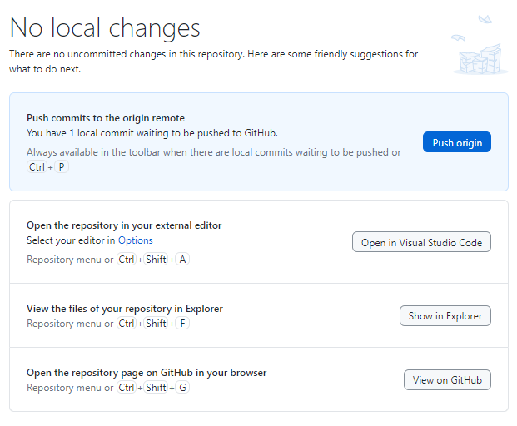
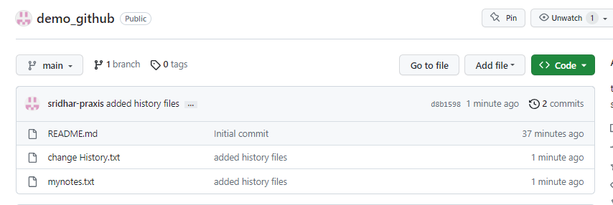
Step 5: Push changes to GitHub
Selecting Push origin
Go to GitHub account and view the repo, the new files are added to this repo

Slide 12
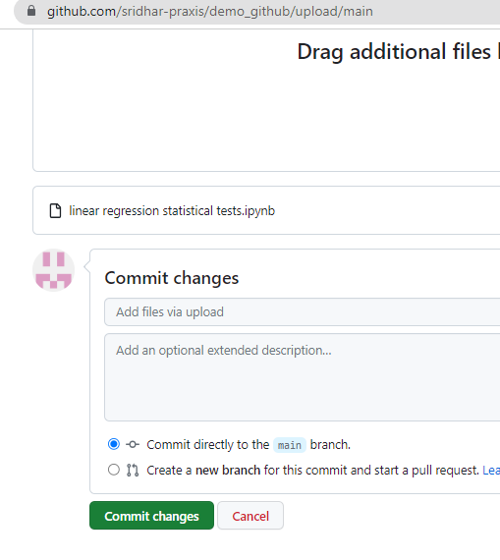

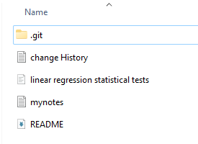
Step 6: Changes to GitHub repo
Upload an existing IPYNB file directly to the same repo in GitHub
Open GitHub Desktop, click Fetch Origin. Then click Pull. This will sync your local repo with GitHub i.e. get that new file also
Click on Repository -> Show in Explorer

Slide 13
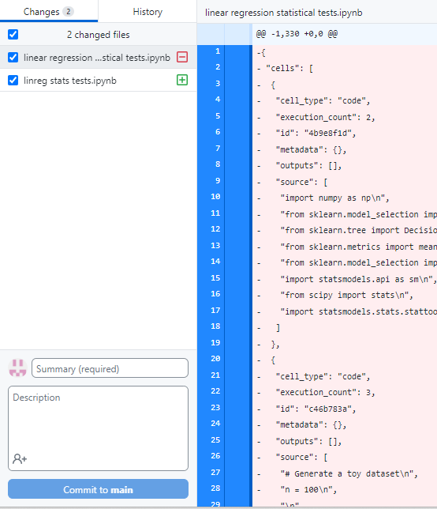
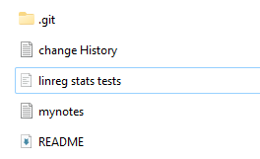
Step 7: Modify code and Push changes
Changes could have been anything. To make a point, I have just renamed the IPYNB file.
Observe the change in GitHub Desktop
Enter change comments and Commit
Push origin to sync changes in origin GitHub repo also

Slide 14
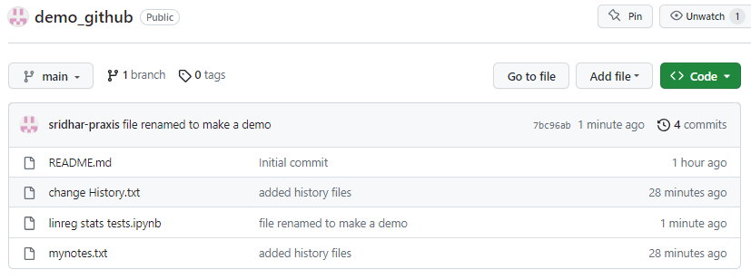
Changes reflecting in GitHub repo

Slide 15
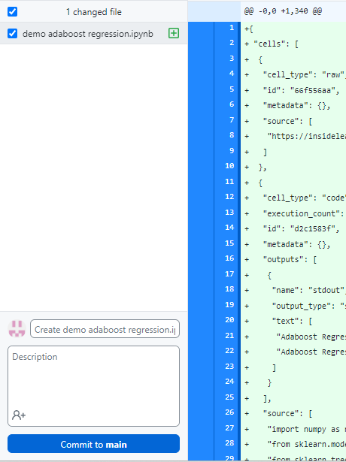
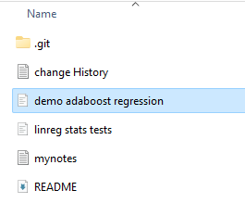
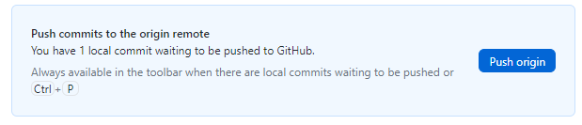
Step 8: Initiate a file locally and Push
In the local cloned repo, add a IPYNB file
Open GitHub Desktop, see the changes
Add a line and Commit

Slide 16
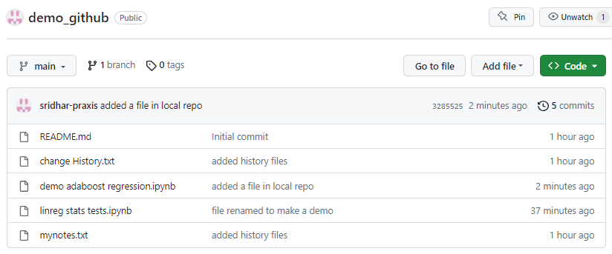

Slide 17
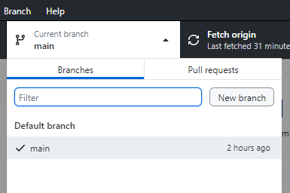
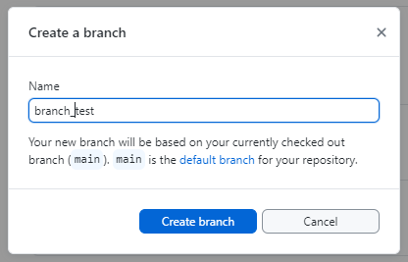
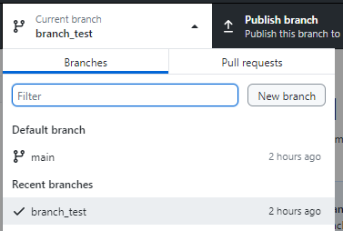
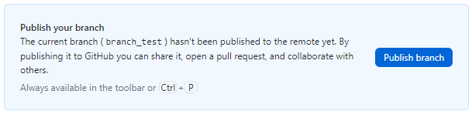
Step 9: Create branch
Click View -> Branch list. There is just main.
Create a new branch by Branch -> New Branch
View –> Branch list again
Publish branch to sync with GitHub account

Slide 18
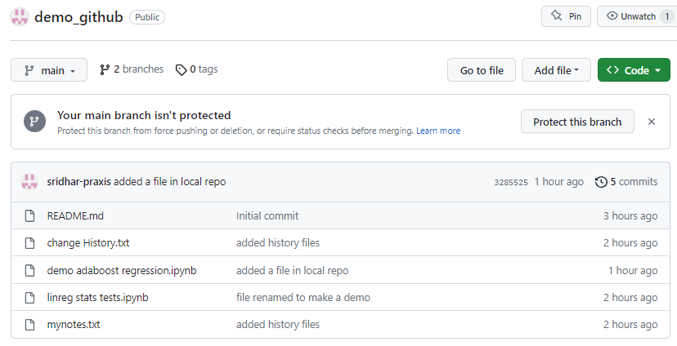
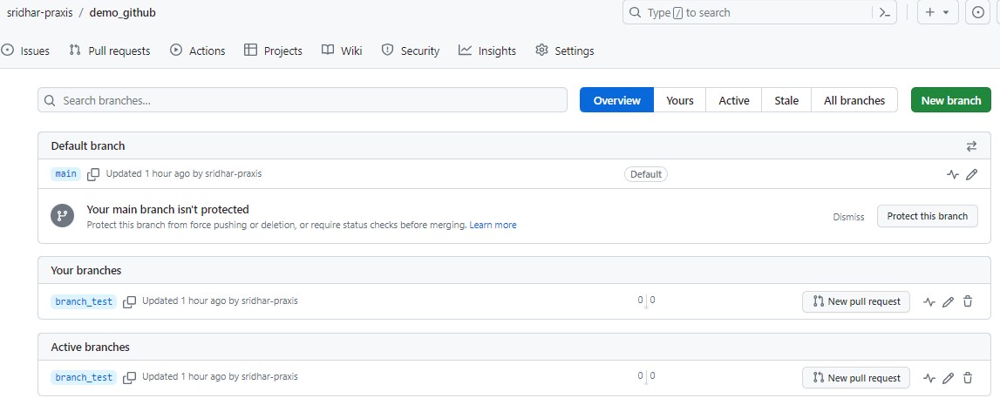

Slide 19
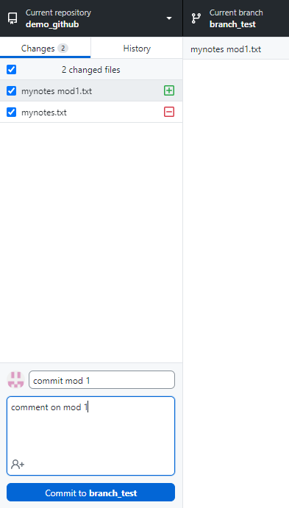
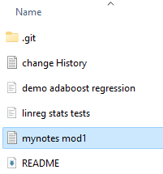
Step 10: Commit to branch
Change in the branch can be anything. To make it visible, renamed a file in the repo.
Commit to branch_test
Push origin

Slide 20
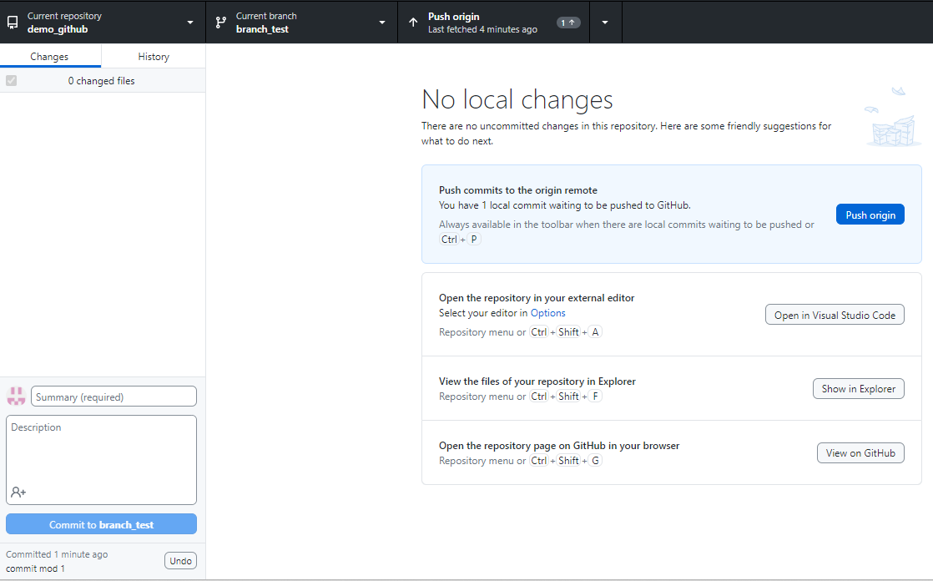

Slide 21
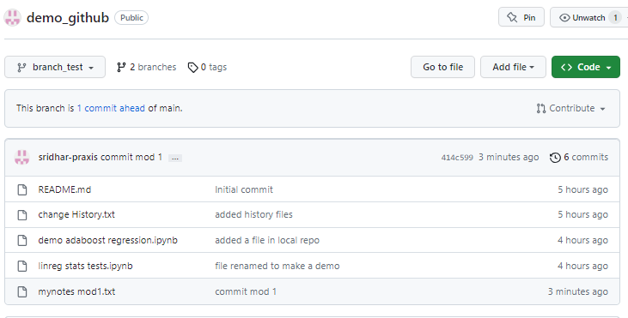

Slide 22
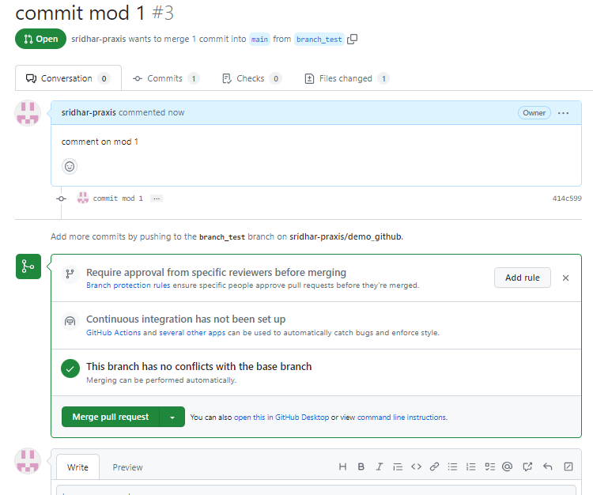
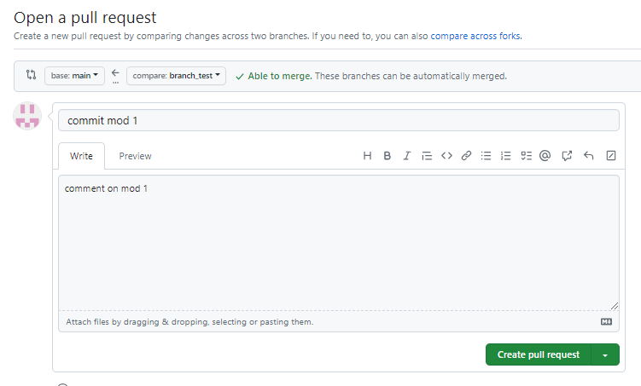
Step 11: Merge branch
Create a pull request on GitHub
Merge pull request and confirm

Slide 23
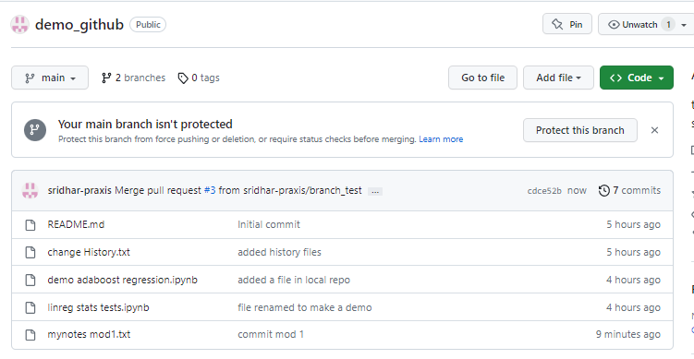
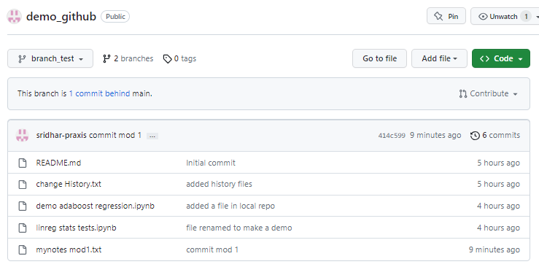
After the merge, main also has the same version

Slide 24
Branching and Merging
Create Branch, this creates a copy of main branch
Work on branch
Commit work -> will go to the branch
Any no of commits are possible. All go to the branch.
Branch remains separate even after commits
Merge branch is optional
You may want to keep branch perpetually or merge with main

Slide 25
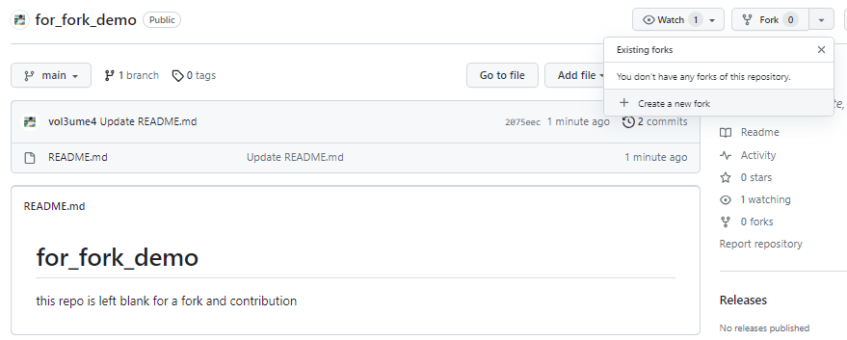
Step 12: Fork
Search any repo from GitHub and Fork it.
I created a dummy GitHub account and a repo in that and am using that.

Slide 26
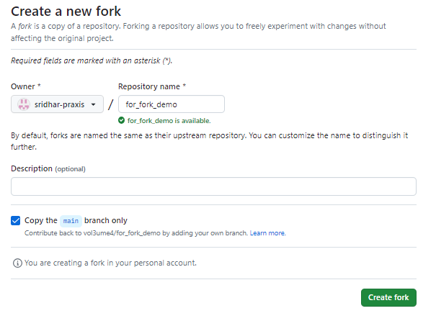

Slide 27
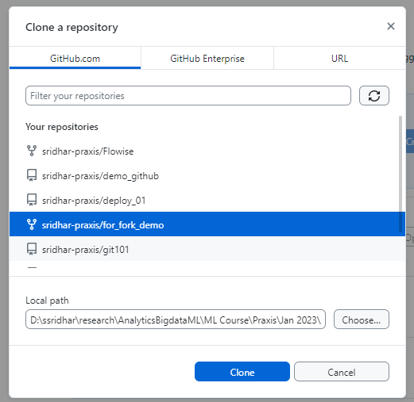
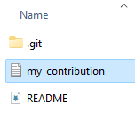
Contd..
Open GitHub Desktop, use File -> Clone
Create a local copy of this repo
To this repo, make a contribution. This can be anything. I created a blank file for demo.

Slide 28
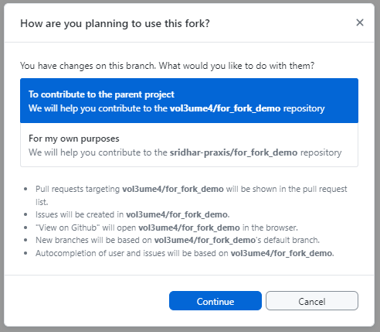

Accept continue
Commit to main with a brief comment
Then click Push Origin button at the top of the window

Slide 29
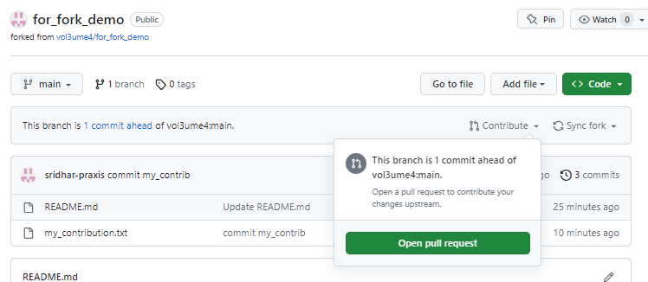
Click on Contribute -> Open Pull request

Slide 30
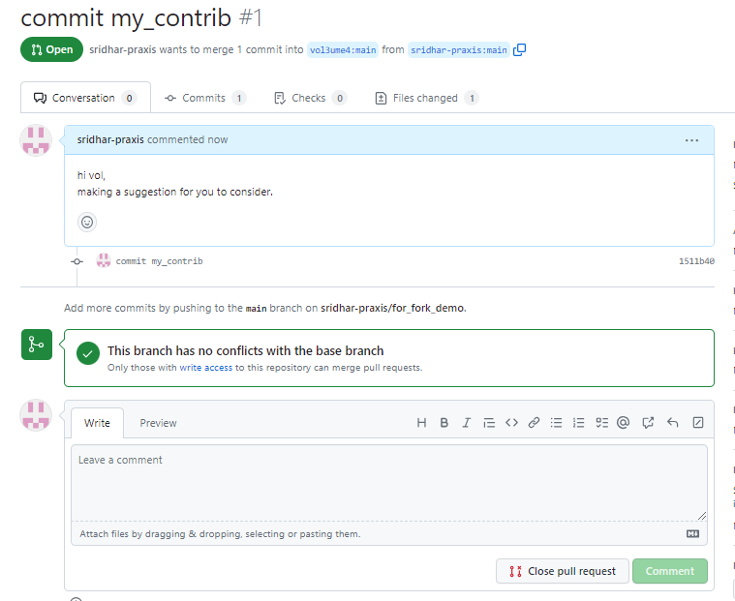

Slide 31
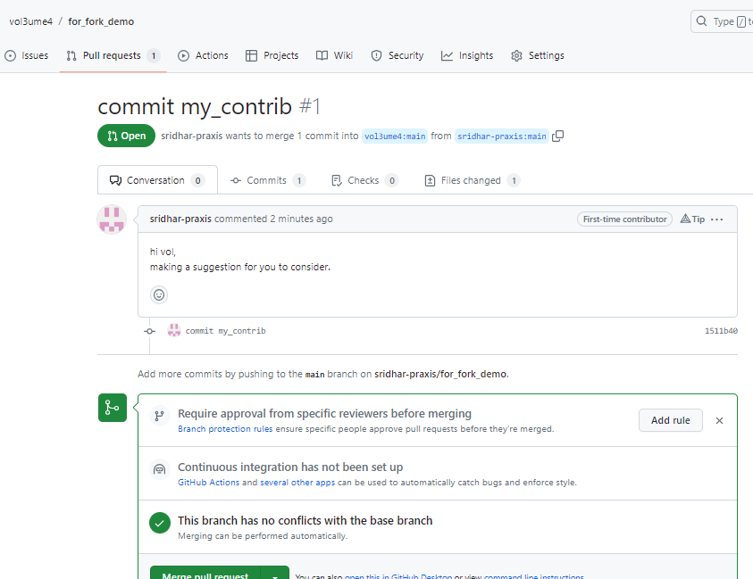
Vol sees a pull request
Reviews
Merge pull request
Confirm Merge

Slide 32
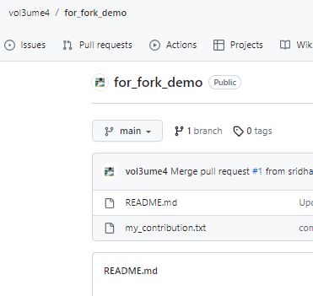
After merge, the contribution appears in the original repo

